Slide 1
Paint Stewardship in Canada Information & Training Tutorial

Slide 2
Introduction
This presentation concerns the paint collection programs in British Columbia, Saskatchewan, Manitoba, New Brunswick, Newfoundland & Labrador, PEI, and Nova Scotia.
Topics covered:
What is the paint collection program and Product care?
What is an eco-fee?
Depot responsibilities.
Accepted and not accepted products in the program.
How to handle accepted material.
Who to contact for service.

Slide 3
What is Product Care?
Product Care Association of Canada (PCA) is a non-profit organization.
PCA manages end-of-life products from consumers (specifically manages the paint collection program).
Product lifecycle:
Consumer purchase → consumer use → collection service→ PCA recycles
In some cases, this can be a circle, ideally the product is recycled back into the same product that the consumer can use again.
The concept of managing products through their lifecycle is known as product stewardship.

Slide 4
What is the Paint Collection Program?
It has been legislated by provincial governments for manufacturers or first importers to manage the end of life for their products.
The paint collection program managed by PCA is the result of these regulations.
Paint that consumers are finished using is collected and processed for recycling.
The paint collection program is funded by “eco-fees”.

Slide 5
What is a Recycling Fee? (Also known as an EFH - Environmental Handling Fee)
An EHF is a fee charged by PCA to its members to fund the product stewardship programs operated by PCA on their behalf under provincial recycling regulations.
The fee is not a government tax and the fee itself is not remitted to government.
Fee rates vary by product type and container size.

Slide 6
What is a Recycling Fee? (Also known as an EFH - Environmental Handling Fee)
Fees are used by PCA to cover recycling program costs for the product, including public education, managing the collection, transportation and recycling system for returned products .
Depending on the business practices and regulations of the provinces where the program operates, manufacturers, retailers and wholesalers may include the recycling fee in the product price or display it as a separate charge to purchasers or both.
In either case, the EHF is part of the product price and is subject to sales tax.

Slide 7
What Service do Collection Sites Provide?
Depots are a key component to the collection system.
They provide a location for consumers to drop off their end-of-life products.
In many cases, the public views them as the program.

Slide 8
The Collection System
Receive program products from the consumer.
This is NOT a self-drop system. Consumer drop-offs MUST be supervised.
Be certain to carefully inspect each container.
Follow PCA collection guidelines.
Pack program products into collection containers.

Slide 9
The Collection System
Collection containers should be stored in an area accessible only to collection site employees.
This area can be either indoors or outside, wherever the best fit is.
If the storage area is outside, it is recommended to weight or strap the lid. down, so that it cannot be blown off by high winds, and the paint is protected from weather.
Contact PCA for service when your collection containers are full.

Slide 10
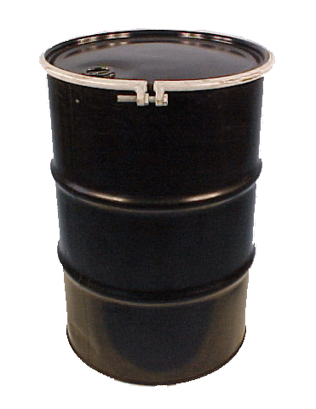
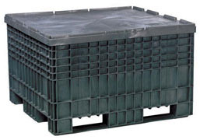
The Collection System
Collection Containers:
45 GALLON DRUM
TUBSKID

Slide 11
Site Safety Requirements
Collection containers must not be accessible to the public.
No leaking or compromised containers can be accepted.
Abandoned containers should approached with caution and handled as hazardous waste.
NEVER open a container to check its contents.
Read the label on each container.

Slide 12
Site Safety Requirements
Always wear safety glasses and gloves when handling dropped off material.
No smoking near the paint collection area.
Practise basic hygiene after handling paint (wash hands).
NOTE: All drop-offs MUST be supervised. Unattended drop-off encourages abandonment and the collection of non-program materials.

Slide 13
Program Products
Architectural Coatings (household type of paints)
Consumer latex, alkyd, enamel and oil-based paints
Porch, floor and deck paints
Interior & exterior varnishes and urethanes
Primers, undercoats, block fillers and sealers
Marine enamels
Wood finishing oils, stains and shellac

Slide 14
Program Products
Latex driveway sealer
Rust paint, decorative metal paint
Fence, barn and swimming pool paint
ANY paint aerosols
Empty cans of the above products (except NS)
Maximum size: 25 litres

Slide 15
Aerosols
Aerosol PAINTS are included in the program and collected in either drums or tubskids.
Any aerosol that is NOT a paint, is NOT to be accepted in the program.
Place aerosol cans into the collection container, and close the lid.
For drums, the ring does not have to be tightened each time.

Slide 16
Non-Program Products
PCA cannot recycle all products.
Many products are not part of the stewardship program and must not be accepted by collection sites.
Any non-program products brought by the consumer must be returned to them and not accepted.
Consumers with non-program product are requested to contact a municipal eco-centre or waste disposal centre in their area for disposal of the product.
Non-program products include, but are not limited to:
Products not listed as Program (accepted) products.
Products without their original label.
Products not in their original container.
Products in leaking or unsealed containers.

Slide 17
Industrial Paint
Some non-program material is obvious (caulking tubes, roof tar, resin, no label, etc.).
Some non-program material is more difficult to identify, such as industrial paint.
Some indicators that a paint is industrial:
- Says “for industrial use only” on the can.
- WHMIS labels are on the can.
- TDG labels are on the can.
- Has a part A and part B (two components).
- Road marking paint.
- Quick drying or rapid cure paints.

Slide 18
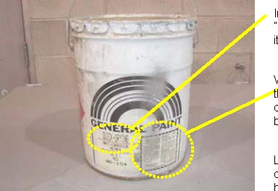
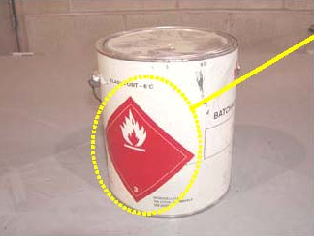
Non-Program Industrial Paint
Indicators on the label such as “quick drying” are usually a sign that it is an industrial product
WHMIS labelling is another indicator that a product is for industrial or commercial-use and not accepted by the program
Other symbols, such as this dangerous goods transportation label, indicate that a container is an industrial product and not acceptable in the program

Slide 19
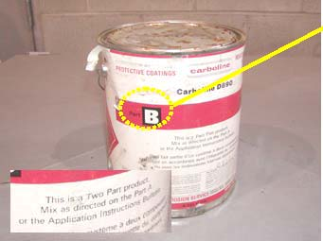
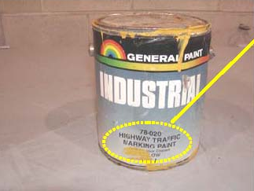
Non-Program Industrial Paint
Part A, part B, or two-part paints are industrial and are therefore unacceptable
Traffic marking paint is an industrial product and is not acceptable

Slide 20
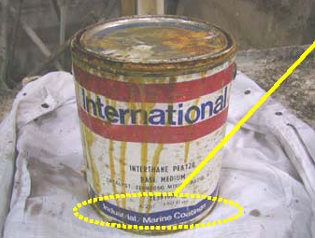
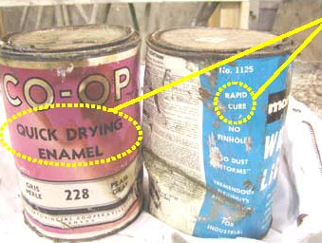
Non-Program Industrial Paint
This is an industrial catalyst and is not acceptable in the program
NO catalysts are accepted by the program
Quick dry, rapid dry, rapid cure, fast dry, etc. are unacceptable as they are industrial paint products

Slide 21
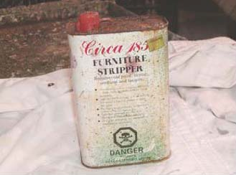
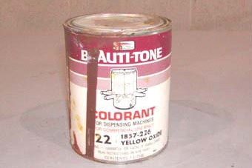
Non-Program Industrial Paint
Colorants, tints and other paint additives are not accepted by the program
Paint strippers are not acceptable

Slide 22
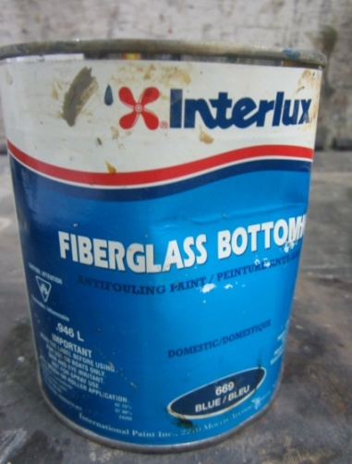
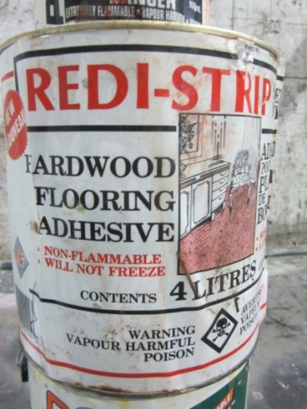
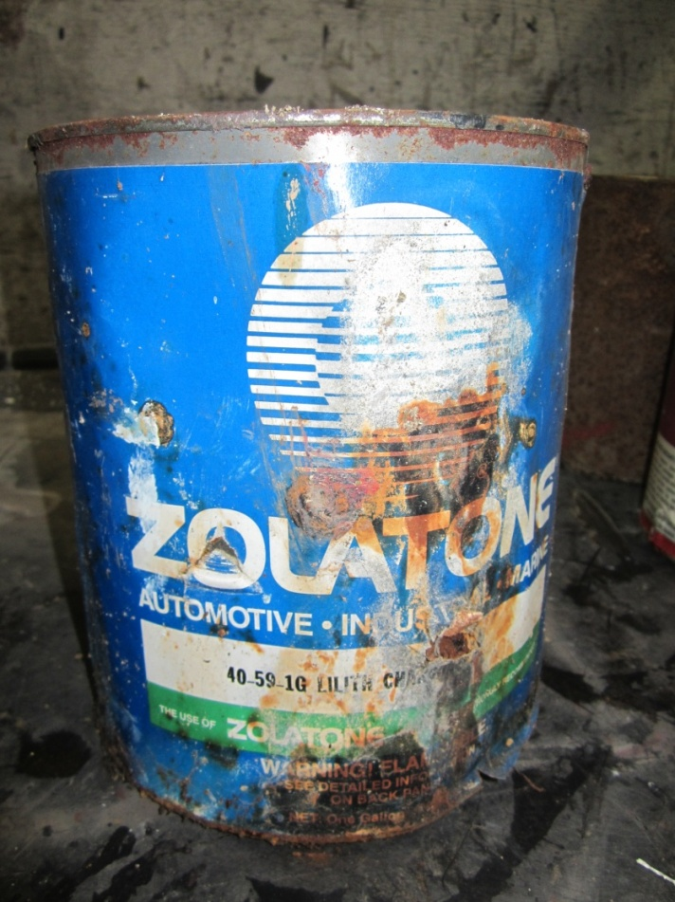
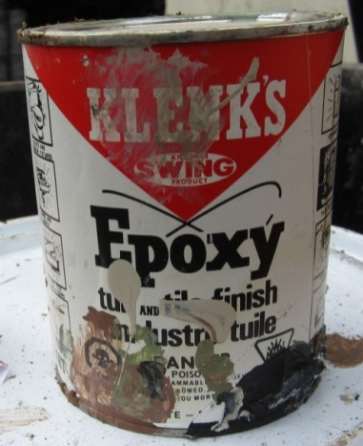
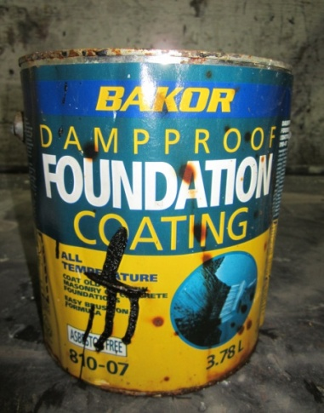
Other Non-Program Products
Adhesives, roof tars, fibreglass resin
Car paint (non aerosol)

Slide 23
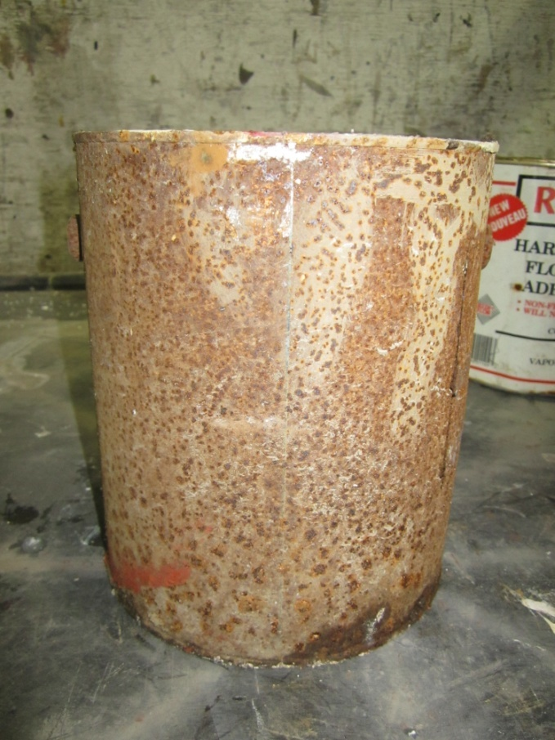
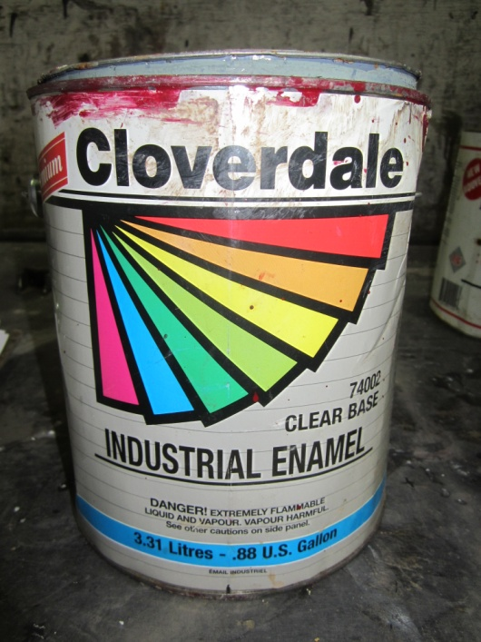
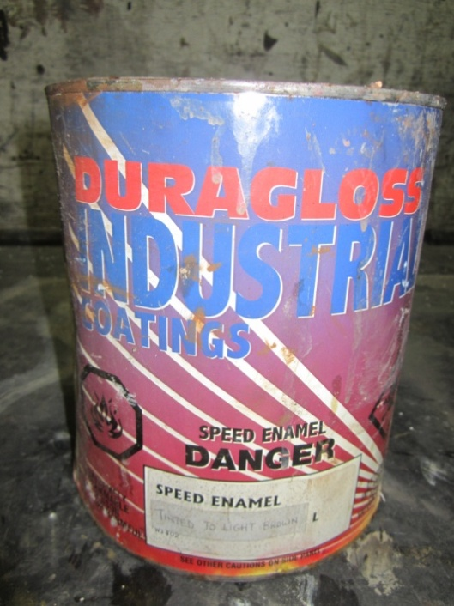
Other Non-Program Products
Leaking or unlabelled containers
Industrial Paint

Slide 24
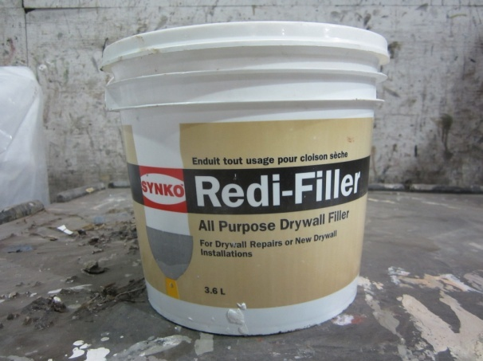
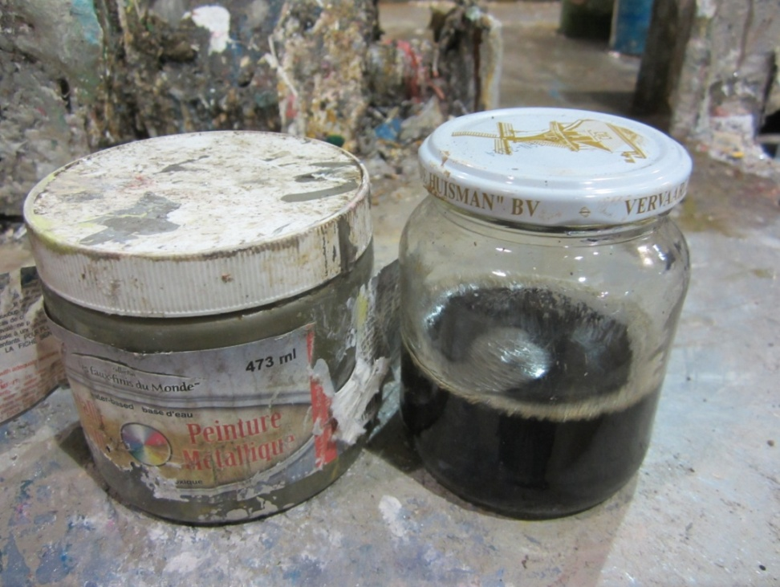
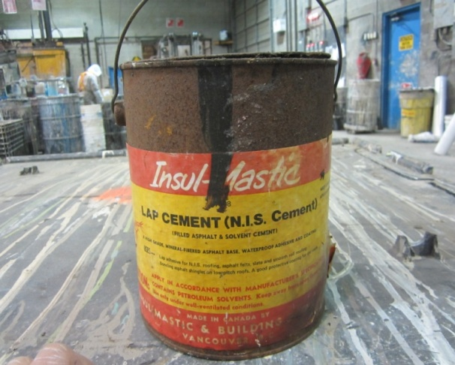
Other Non-Program Products
Materials not in their original containers
Cement, dry wall mud, grout

Slide 25
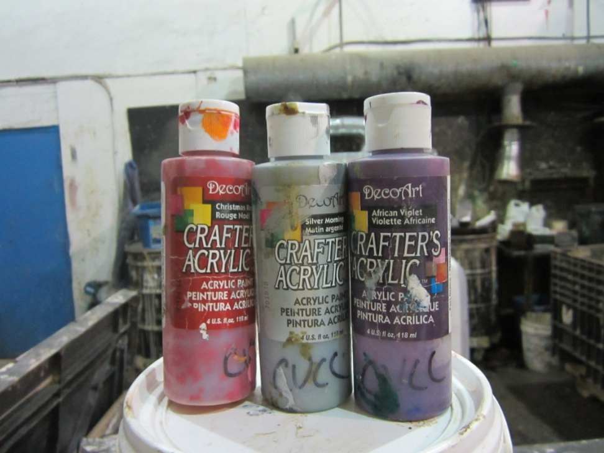
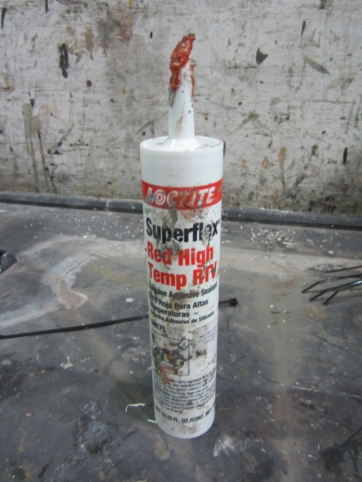
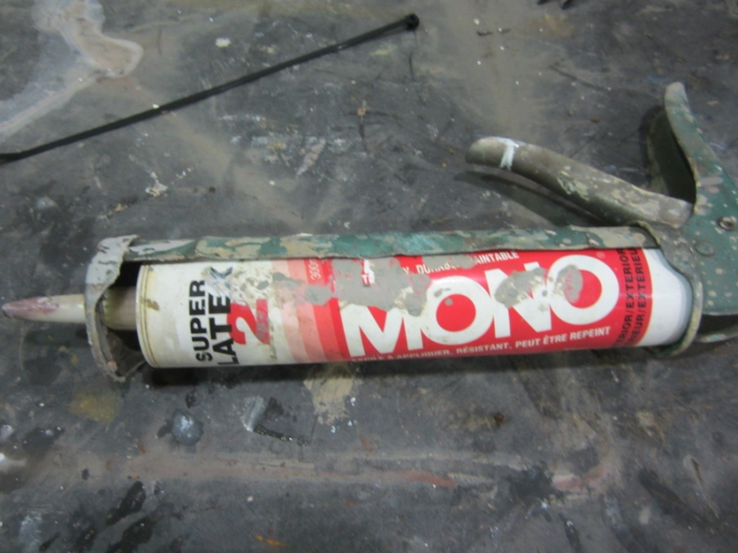
Other Non-Program Products
Craft Paint
Caulking Tubes

Slide 26
Collection Containers
Paint:
Tubskid (4’x4’x3’) plastic box
For paint products
200 litre (45 gallon) drums
Pack paint aerosols into drums
Not all collection sites

Slide 27
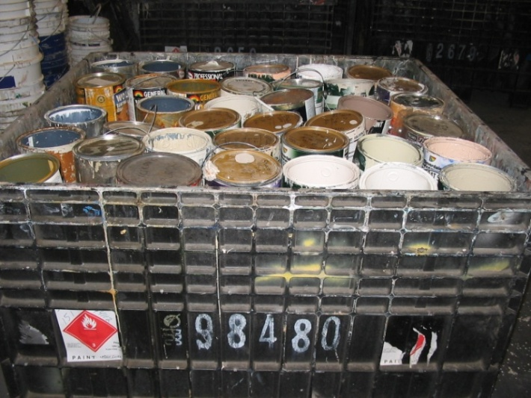
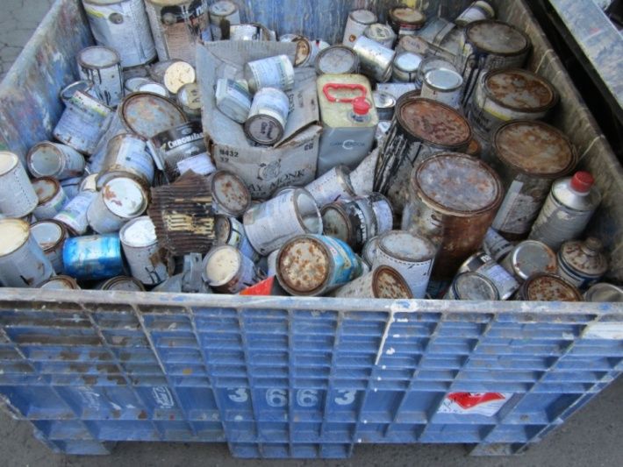
Packing Paint Products
The Products are to be loosely packed, upright into collection containers.
Do NOT empty out the containers!
Place heavier 20 litre (5 gallon) pails in the bottom of the tubskid.
Provides stability.
Always close the lid following packing to keep rain out.
ACCEPTABLE
UNACCEPTABLE

Slide 28
Paint: Full Collection Containers
Once half of any type of collection containers are full, you must contact PCA or the appropriate contractor for service (see following slide).
Your pick-up will be scheduled.
On the day of the scheduled pick-up, the driver will arrive.
Ensure the collection containers are accessible and ready to ship.
The driver will provide paperwork and labels for the containers.
Review the paperwork for accuracy and sign off.
Assist with loading the collection containers into the truck.
Empty collection containers to replace the full ones picked up will either be dropped off simultaneously, or arrive prior to the pick-up of the full ones.

Slide 29
Service Contacts
BC (Southern Interior)
- Battery Doctors @ 250-860-2866
BC (All Other Regions)
- PCA @ 1-877-592-2972 ext. 205
SK
- PCA @ 1-877-592-2972 ext. 202
MB
- PCA @ 1-877-592-2972 ext. 213
NL
- Hebert’s Recycling 709-747-4789 (Avalon, Burin, & Bonavista Peninsula)
- Hebert’s Recycling 709-634-3464 (West of Gloverton)
- Hodge Brothers Transport 709-282-5000 (Labrador)
NB
Hebert’s Recycling 506-773-1880

Slide 30
Contact At PCA
For any other questions regarding the Program,
please contact us at:
Lori@productcare.org

Slide 31
Thank You

